Slide 1
Tidyverse for proteomics
Elloise Coyle

Slide 2
Overview
Introduction to R and tidyverse
Tidyverse- key functions and example application to proteomics dataset
Ressources

Slide 3
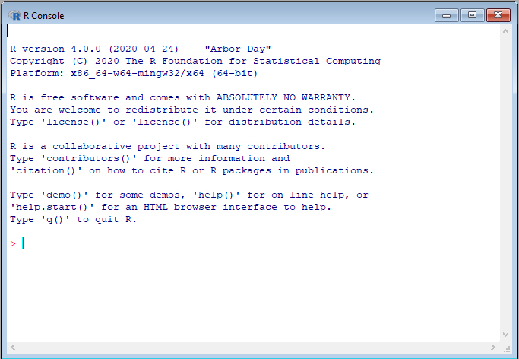

A quick introduction to R
R is a programming language and software environment for statistical computing and data analysis.
To Download: https://www.r-project.org/
Advantages:
Open-source and free:
Popular in data science, statistics, and bioinformatics
Offers a wide range of statistical techniques: regression, time-series analysis, clustering, etc.

Slide 4

How to run R on your PC
RStudio: Integrated Development Environment (IDE) for R.
To Download: https://posit.co/download/rstudio-desktop/
Advantages:
User-friendly interface: Script editor, console, file explorer, and plots all in one place.
Tools: Debugging, package management, visualizations, and integrated help.
Ideal for working with larger projects and more complex analysis.

Slide 5
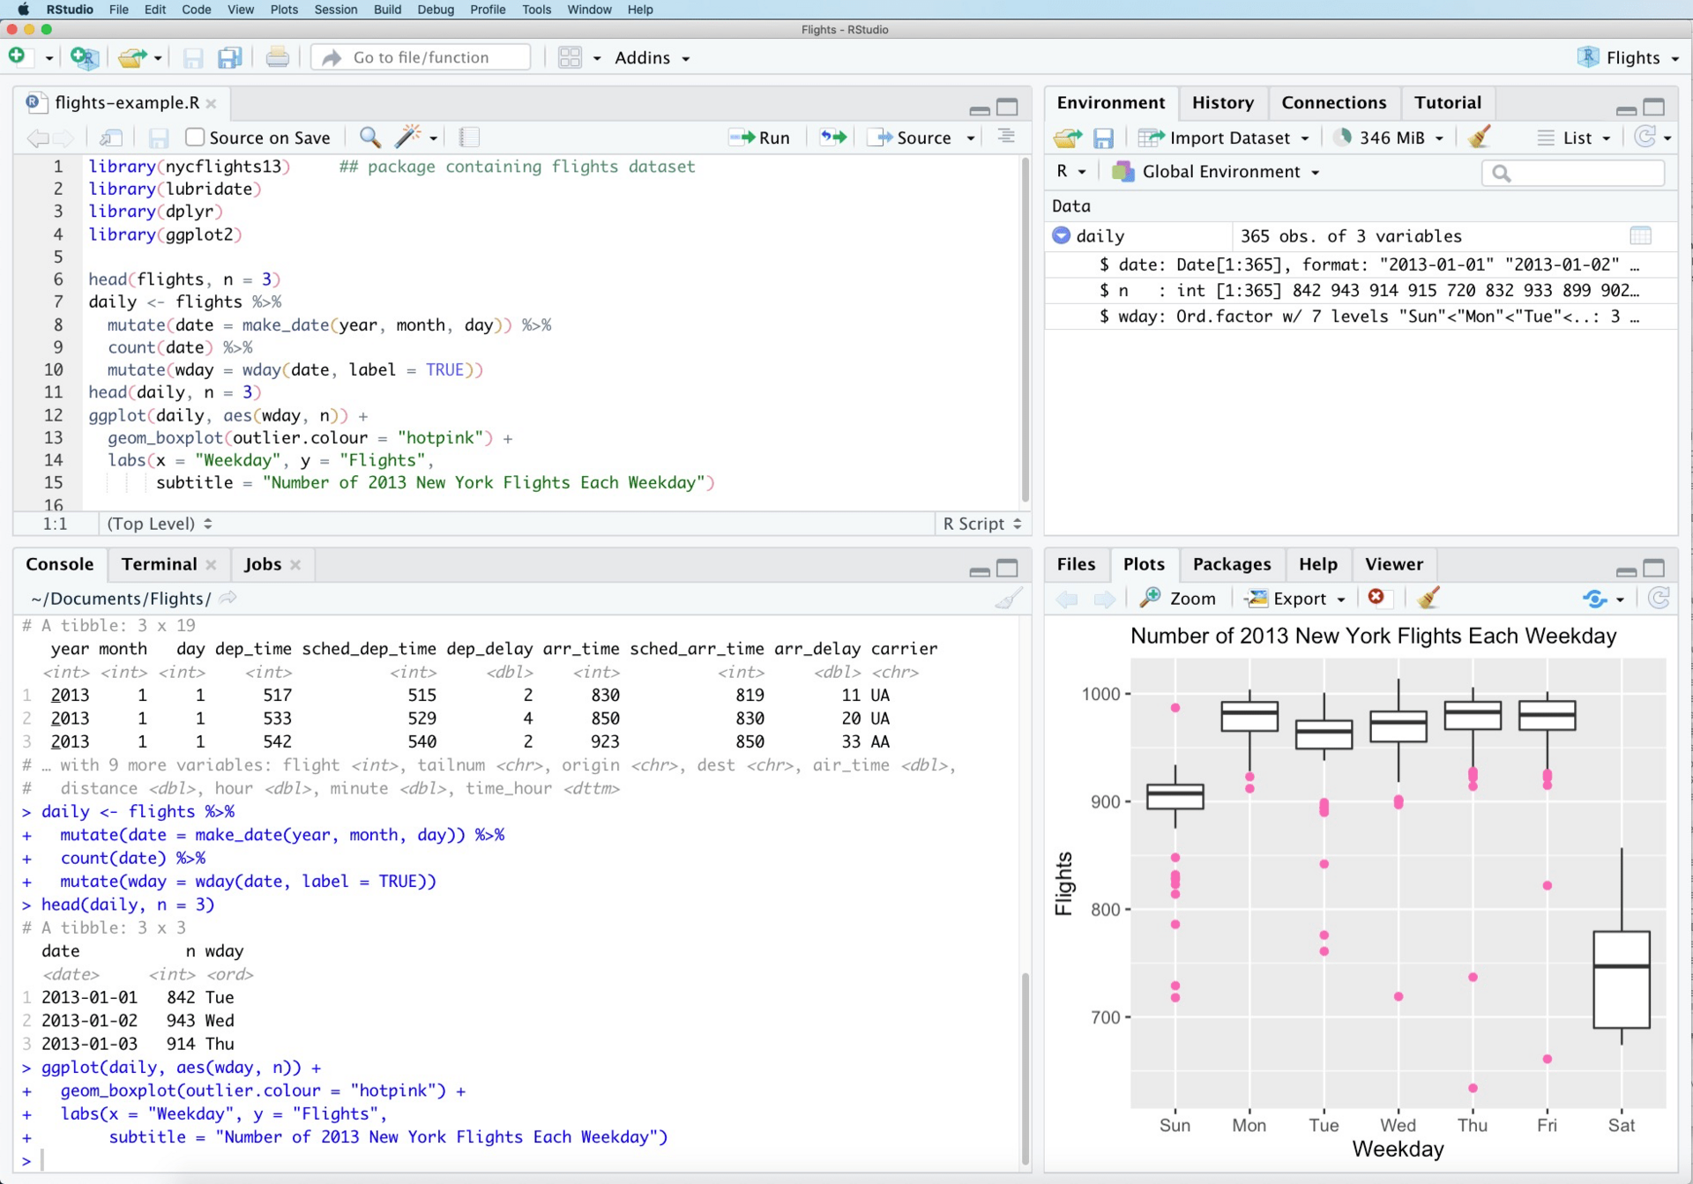
RStudio
Environment
Script
Console

Slide 6
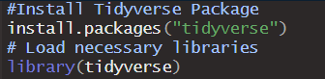
What are Libraries in R?
Definition: Libraries (or packages) are collections of pre-written functions that extend R's functionality.
Advantages:
Libraries help avoid reinventing the wheel by providing tested code for common tasks.
Libraries add additional functionalities into base R (i.e.: reading specific file types, running code in parallel)
Comments to clarify code meaning
Code to install package (only run once)
Code to load package into current environment (Run each time)

Slide 7

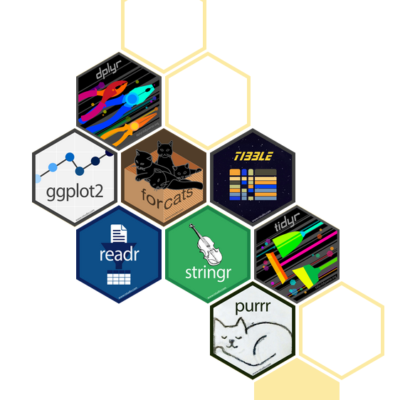
Tidyverse
The Tidyverse is a collection of R packages created by Hadley Wickham and the RStudio team, designed to make data science tasks like cleaning, visualizing, and modeling data easier and more efficient.
Advantages over Base R:
Consistency: Similar syntax across all packages.
Readability: Code is cleaner and easier to understand.
Pipe Operator (%>%): Simplifies chaining functions together.
Tibbles: Enhanced data frames that are easier to work with and more user-friendly.

Slide 8

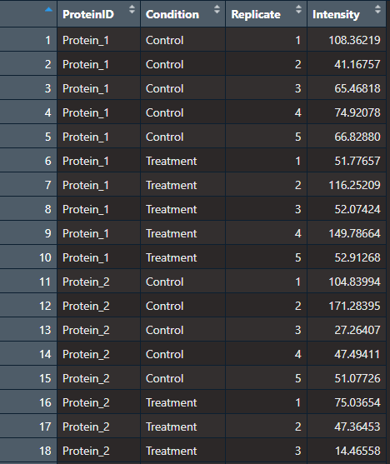
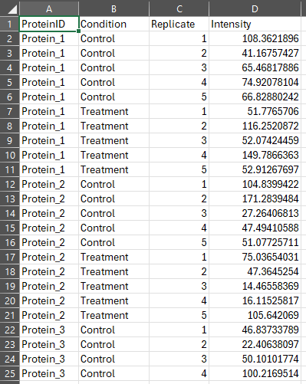
Import example Data
read_csv()
CSV file- proteomics_sample_data.csv
Tibble in R

Slide 9
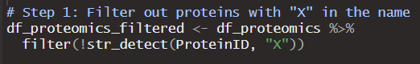
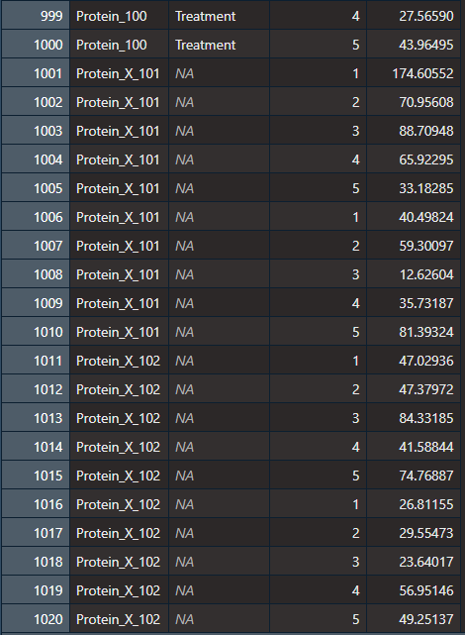
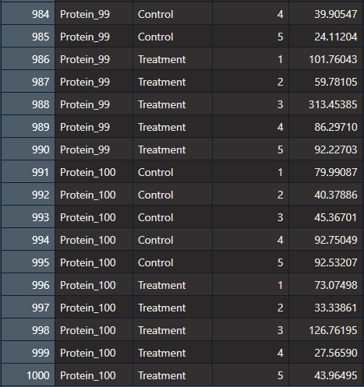
Filtering unwanted lines
filter()
str_detect()
df_proteomics - 1020 lines
df_proteomics_filtered - 1000 lines

Slide 10
Step 1: Breakdown
Input:
df_proteomics: A data frame with proteomics data, containing columns such as ProteinID, Condition, Replicate, and Intensity.
Steps:
Use filter() to keep only rows that meet our criteria.
Use str_detect(ProteinID, "X") to check if the ProteinID column contains an "X".
Apply “!” (Negation) to exclude rows where "X" is detected in ProteinID.
Output:
df_proteomics_filtered: A new data frame without any proteins that have an "X" in their name.

Slide 11
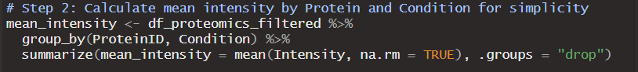
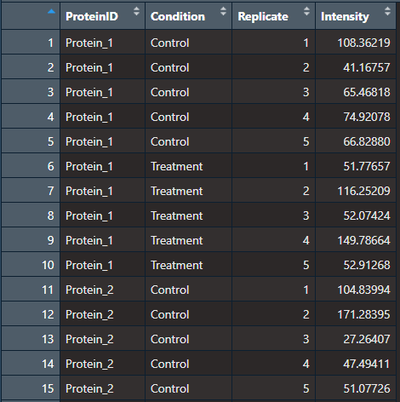
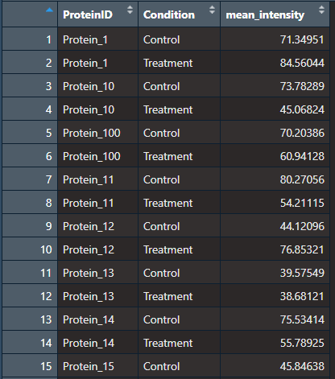
Calculate mean intensity by Protein and Condition
Group_by()
Summarize()
df_proteomics_filtered - 1000 lines
df_proteomics_filtered - 200 lines

Slide 12
Step 2: Breakdown
Input:
df_proteomics_filtered: A filtered data frame containing only relevant proteins, with columns ProteinID, Condition, Replicate, and Intensity.
Steps:
Group Data by Protein and Condition: Use group_by(ProteinID, Condition) to create groups for each unique combination of protein and condition.
Calculate Mean Intensity: Within each group, use summarize(mean_intensity = mean(Intensity, na.rm = TRUE)) to calculate the mean intensity while ignoring any NA values.
Remove Grouping (.groups = "drop"): This argument removes grouping from the final output, returning a flat data frame.
Output:
mean_intensity: A new data frame with the mean intensity for each protein under each condition. This table will have columns ProteinID, Condition, and mean_intensity.

Slide 13
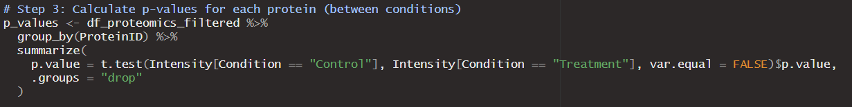
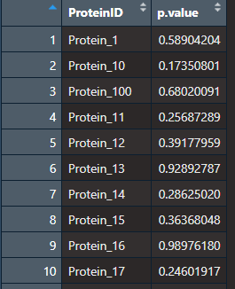
Calculate p-values for each protein between conditions
Control
Vs
Treatment
Group_by()
Summarize()
t.test()
p_values - 100 lines
df_proteomics_filtered - 1000 lines

Slide 14
Step 3: Breakdown
Input:
df_proteomics_filtered: A filtered data frame containing intensity measurements for each protein under different conditions.
Steps:
Group Data by Protein: Use group_by(ProteinID) to calculate statistics for each individual protein across conditions.
Perform a t-test: For each protein, conduct a t-test comparing intensity values between the "Control" and "Treatment" conditions, using t.test(Intensity[Condition == "Control"], Intensity[Condition == "Treatment"]).
Extract the p-value: Save the resulting p-value to assess statistical significance.
Remove Grouping (.groups = "drop"): Removes grouping from the output for a flat data structure.
Output:
p_values: A data frame with columns ProteinID and p.value, containing the calculated p-value for each protein comparing the two conditions.

Slide 15
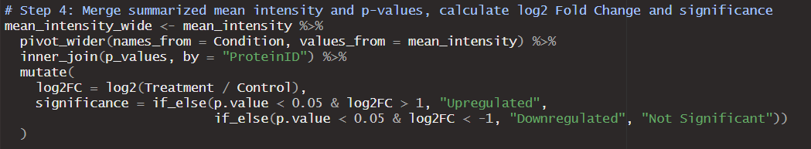
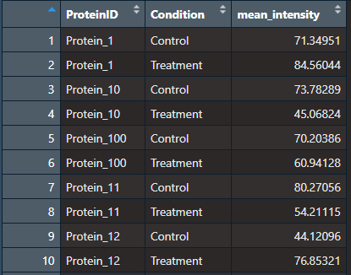
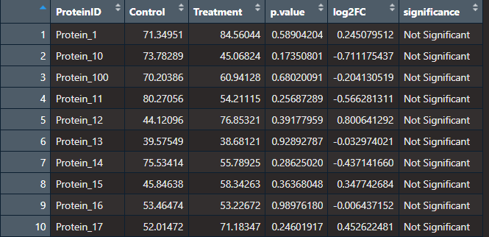
Merge summarized mean intensity and p-values, calculate log2 Fold Change and significance
Pivot_wider()
Inner_join()
Mutate()

Slide 16
Step 4: Breakdown
Input:
mean_intensity: A data frame with mean intensity values by ProteinID and Condition.
p_values: A data frame with p-values for each protein, indicating significance between conditions.
Steps:
Reshape Mean Intensity Data: Use pivot_wider() to convert mean_intensity into a wide format with separate columns for Control and Treatment mean intensities.
Join Data: Use inner_join() to merge the reshaped mean intensity data with p_values by ProteinID.
Calculate Log2 Fold Change: Use mutate(log2FC = log2(Treatment / Control)) to compute the log2 fold change for each protein between conditions.
Determine Significance: Add a new column significance to classify each protein as "Upregulated," "Downregulated," or "Not Significant" based on thresholds of p-value and fold change.
Output:
mean_intensity_wide: A final data frame with ProteinID, Control, Treatment, p.value, log2FC, and significance columns.

Slide 17
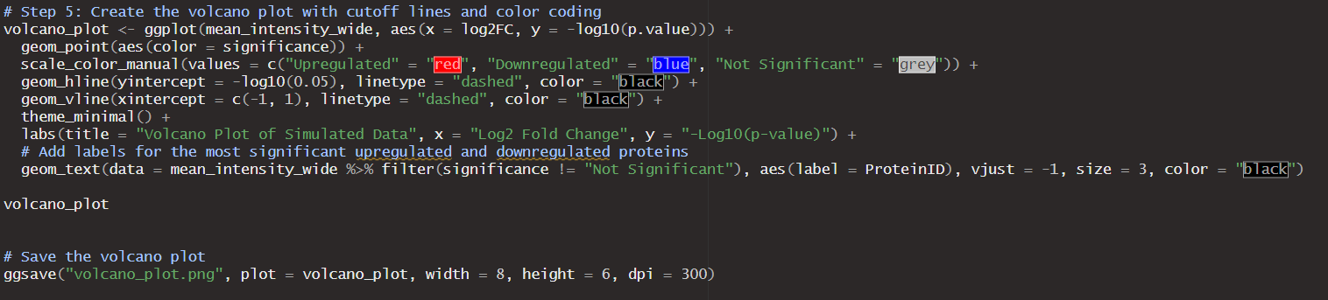
Create the volcano plot with cutoff lines and color coding

Slide 18
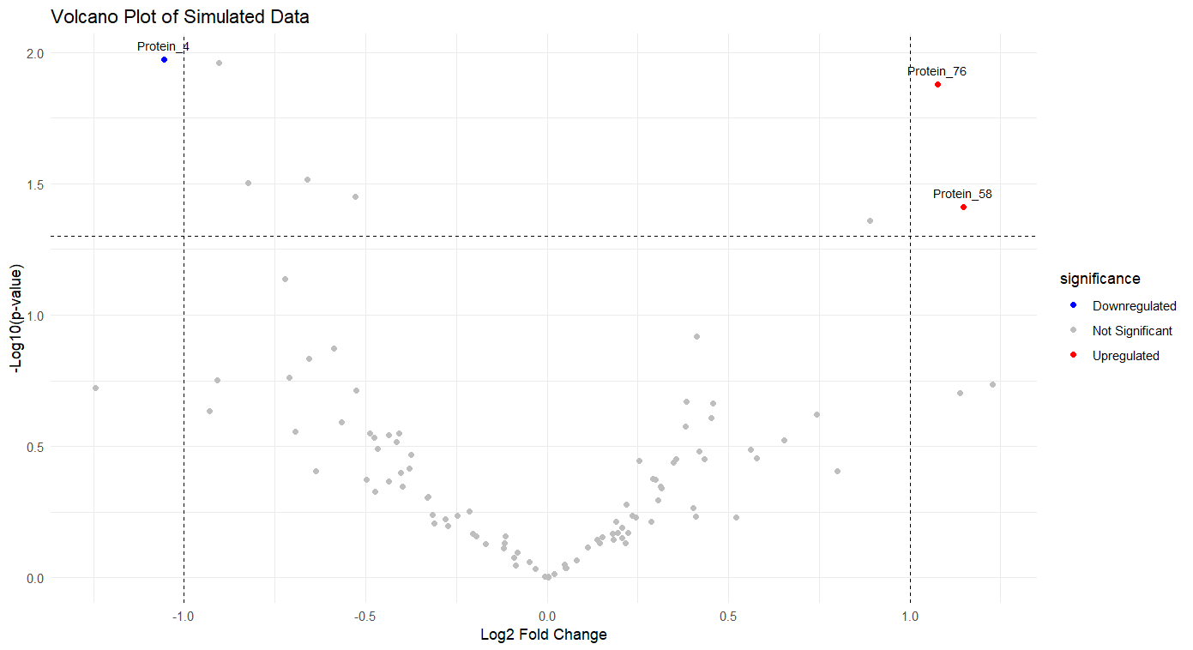
The generated volcano plot

Slide 19
Step 5: Breakdown
Input:
mean_intensity_wide: A data frame containing ProteinID, Control, Treatment, p.value, log2FC, and significance columns.
Steps:
Set Up Plot: Use ggplot() to initialize the plot, with log2FC on the x-axis and -log10(p.value) on the y-axis.
Plot Points: Use geom_point() to plot each protein, with colors representing significance categories: "Upregulated" (red), "Downregulated" (blue), and "Not Significant" (grey).
Add Cutoff Lines: Use geom_hline() and geom_vline() to add dashed lines marking statistical significance (p < 0.05) on the y-axis and fold change cutoffs (log2FC ±1) on the x-axis.
Add Labels: Use geom_text() to label the most significant proteins with their ProteinID if they’re categorized as "Upregulated" or "Downregulated.“
Customize Appearance: Apply theme_minimal() for a clean look, and use labs() to set axis labels and a title.
Output:
volcano_plot: A volcano plot visualizing proteins' significance and fold change, saved as volcano_plot.png (8x6 inches, 300 dpi).

Slide 20
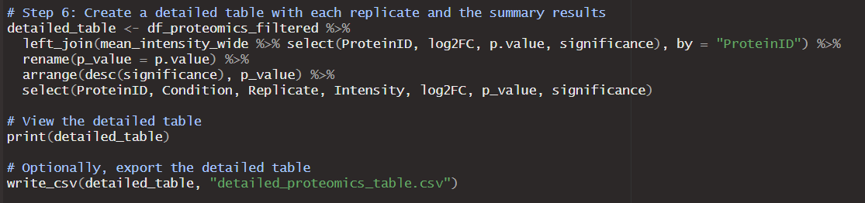
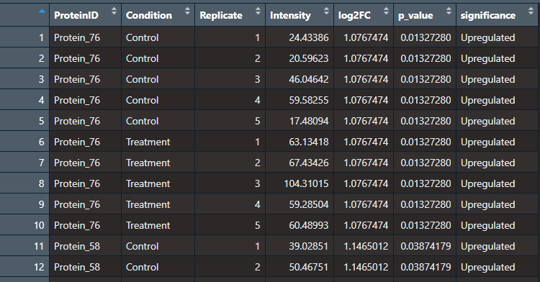
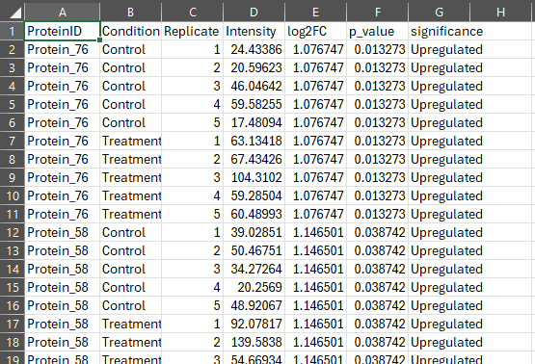
Create a detailed table to export

Slide 21
Step 6: Breakdown
Input:
df_proteomics_filtered: The filtered proteomics data frame with individual replicate intensity values.
mean_intensity_wide: A data frame containing summary statistics for each protein, including log2FC, p.value, and significance.
Steps:
Join Tables: Use left_join() to merge df_proteomics_filtered with selected summary columns (log2FC, p.value, significance) from mean_intensity_wide by ProteinID.
Rename p-value Column: Rename p.value to p_value for readability using rename().
Arrange Rows: Use arrange(desc(significance), p_value) to sort proteins, ordering by p-value.
Select Columns: Use select() to reorder and include only relevant columns: ProteinID, Condition, Replicate, Intensity, log2FC, p_value, and significance.
Output:
detailed_table: A comprehensive data frame showing each protein’s individual replicate intensities along with summary statistics. This table is saved as detailed_proteomics_table.csv.

Slide 22

Ressources
R for Data science: https://r4ds.hadley.nz/
Tidyverse website: https://www.tidyverse.org/
Diann R package: https://github.com/vdemichev/diann-rpackage
All Code and data seen today available at: https://github.com/Ellcoy/Proteomics_Tidyverse
If you have questions or need to contact me: elloise.coyle@crchudequebec.ulaval.ca

Slide 23
Questions?

Slide 24

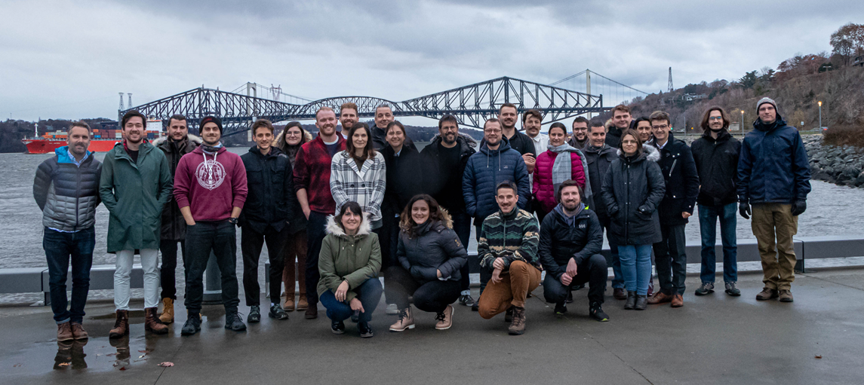



Thank-you!

